Slide 1
DEPLOYMENT Of APPLICATION ON KUBERNETES
Submitted in the partial fulfillment for the award of the degree of
MASTER OF ENGINEERING
IN
COMPUTER SCIENCE WITH SPECIALIZATION IN CLOUD COMPUTING
Submitted by:
Syed imran(22mcc10005)
MOHD AMAAN KHAN (22mcc10003)
Under the Supervision of:
MR Digvijay Puri
Department of AIT-CSE
DISCOVER . LEARN . EMPOWER

Slide 2

Outline
Introduction to Project
Problem Formulation
LITERATURE SURVEY
Working
Objectives of the work
References

Slide 3
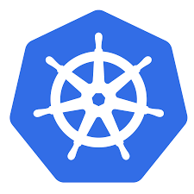
Introduction
Kubernetes, also known as K8s, is an open-source container orchestration platform developed by Google. It automates the deployment, scaling, and management of containerized applications.
Containers are a lightweight and portable way to package and run applications. Kubernetes provides a way to manage these containers and their applications in a scalable and efficient manner. It allows you to deploy and manage multiple containers across a cluster of machines, providing high availability and fault tolerance.
Kubernetes provides a powerful set of APIs and tools for managing containers, including automatic scaling, rolling updates, and self-healing. It also provides a range of features for managing storage, networking, and security.
Kubernetes is widely used in production environments to manage containerized applications and is supported by many cloud providers, including Google Cloud Platform, Microsoft Azure, and Amazon Web Services.

Slide 4
Problem Formulation
Before Docker, application deployment was typically done using virtual machines or physical servers. Applications were typically installed and configured manually, which was a time-consuming and error-prone process.
Deploying applications on virtual machines involved creating a new virtual machine, installing the operating system, configuring the required software, and then deploying the application. This process was slow and resource-intensive, and it often required manual intervention to scale or update the application.
Deploying applications on physical servers required even more effort, as it involved installing and configuring the operating system and all the required software manually. This process was even more time-consuming and difficult to scale or update.
In addition, application deployment was often done using custom scripts or configuration files that were specific to each application and environment. This made it difficult to standardize and automate the deployment process, resulting in inconsistencies and errors.
Kubernetes, also known as K8s, is an open-source container orchestration platform developed by Google. It automates the deployment, scaling, and management of containerized applications.
Containers are a lightweight and portable way to package and run applications. Kubernetes provides a way to manage these containers and their applications in a scalable and efficient manner. It allows you to deploy and manage multiple containers across a cluster of machines, providing high availability and fault tolerance.

Slide 5
LITERATURE SURVEY
[1]. L. Lin, Y. Gao, and H. Shen delivered this work titled "An Empirical Study on the Use of Kubernetes for DevOps" at the International Conference on Cloud Computing and Big Data (CCBD 2021). The study's objective was to conduct an empirical investigation to learn more about how Kubernetes is used in DevOps practises. The adoption of Kubernetes by organisations, as well as the advantages and difficulties of using it in a DevOps environment, are examined in this article. The report also identifies the critical elements that are necessary for Kubernetes to be implemented successfully in a DevOps environment. The findings of a poll the authors performed among DevOps experts showed that Kubernetes is extensively used and that it aids in automating the deployment, scaling, and administration of containerized applications. According to the report, organisations' primary obstacles to adopting Kubernetes for DevOps are a lack of experience and the software's complexity. Overall, the report offers insightful information about the use of Kubernetes in DevOps and can be a helpful resource for businesses considering including Kubernetes in their DevOps workflows.
[2]. C. Xu and Y. Sun The paper "DevOps for Kubernetes: A Survey and Future Research Directions," by C. Xu and Y. Sun, offers an overview of the state of DevOps practises and tools for Kubernetes at the moment. The complexity of the technology and the requirement for specialised skills are just two of the difficulties the authors mention while adopting DevOps for Kubernetes. Additionally, they examine the current Continuous Integration/Continuous Delivery (CI/CD), monitoring, and logging DevOps tools and procedures for Kubernetes. The discussion of potential future research topics in DevOps for Kubernetes, including enhancing the interaction of Kubernetes and DevOps technologies and creating new tools and methods for managing Kubernetes at scale, finishes the study.

Slide 6
Cont…
[1]. Y. Zhang and H. Yu A DevOps pipeline based on Kubernetes and Jenkins is suggested in the work by Y. Zhang and H. Yu. The methodology includes developing and executing a DevOps pipeline that combines the Jenkins continuous integration and continuous deployment (CI/CD) tool with the Kubernetes container orchestration platform. Source code management, building and packaging, testing, and deployment are the four primary stages of the pipeline as it is currently being proposed. The proposed DevOps pipeline is shown to be effective by the authors in terms of lowering manual labour requirements, boosting productivity, and guaranteeing code quality through the inclusion of a case study. Software development teams employ a DevOps pipeline, which is a series of automated steps, to build, test, and reliably deliver software applications. The pipeline begins with the development stage, during which code alterations are produced and entered into version control databases. The code is then automatically compiled, tested, and merged with the main branch as part of continuous integration (CI), which follows the code changes. The code is then put through continuous delivery (CD), where the production environment is automatically deployed. Automated testing, code review, and monitoring are also included in the pipeline to guarantee that the software is of the highest quality and that any flaws are found early in the development process. Software development teams can speed up and enhance the quality of their application delivery by adopting a DevOps pipeline to optimise their development process.
[2]. H. Cheng and X. Li The obstacles and best practises of implementing DevOps for Kubernetes are covered in the paper "DevOps for Kubernetes: Challenges and Best Practises" by H. Cheng and X. Li, which was published in the Proceedings of the International Conference on Information and Computer Technologies (ICICT 2021). When adopting DevOps on Kubernetes, organisations encounter difficulties with scalability, complicated infrastructure management, and continuous deployment, among others. They also offer a number of best practises, such as employing automation tools, building a microservices architecture, and putting security measures in place, for deploying DevOps on Kubernetes. The significance of collaboration and communication between development and operations teams is emphasised in the paper's conclusion in order to ensure a successful DevOps implementation on Kubernetes. Microservices are a design strategy for creating software systems that are made up of a number of tiny, independent services that connect with one another via well defined APIs. In a microservices architecture, each service is in charge of a particular business capability and has its own autonomous development, deployment, and scaling capabilities. With this method, software development is encouraged to be modular, agile, and scalable, and organisations are better able to adapt to shifting business needs.

Slide 7
Cont…
[3]. T. Zhang and H. Zhang In this paper, a brand-new DevOps framework built on the microservices architecture and Kubernetes is proposed. The authors talk about the problems with conventional DevOps methods and how the suggested framework might solve them. The framework makes use of Kubernetes features like service discovery, automated scaling, and container orchestration to speed up the deployment and administration of microservices-based applications. The framework's implementation is also discussed, and the authors offer test results that show how effective it is in terms of scalability and fault tolerance. The report ends by offering potential future research topics for enhancing the suggested framework. It appears that the authors suggested a brand-new Kubernetes- and microservices-based DevOps framework. The framework was probably designed and put into use, tested in a simulated or real-world setting, and then its efficiency in terms of enhancing DevOps operations was assessed.
[4]. Y. Zhang and H. Yu A DevOps pipeline based on Kubernetes and Jenkins is suggested in the work by Y. Zhang and H. Yu. The methodology includes developing and executing a DevOps pipeline that combines the Jenkins continuous integration and continuous deployment (CI/CD) tool with the Kubernetes container orchestration platform. Source code management, building and packaging, testing, and deployment are the four primary stages of the pipeline as it is currently being proposed. The proposed DevOps pipeline is shown to be effective by the authors in terms of lowering manual labour requirements, boosting productivity, and guaranteeing code quality through the inclusion of a case study. Software development teams employ a DevOps pipeline, which is a series of automated steps, to build, test, and reliably deliver software applications. The pipeline begins with the development stage, during which code alterations are produced and entered into version control databases. The code is then automatically compiled, tested, and merged with the main branch as part of continuous integration (CI), which follows the code changes. The code is then put through continuous delivery (CD), where the production environment is automatically deployed. Automated testing, code review, and monitoring are also included in the pipeline to guarantee that the software is of the highest quality and that any flaws are found early in the development process. Software development teams can speed up and enhance the quality of their application delivery by adopting a DevOps pipeline to optimise their development process.
[5]. H. Cheng and X. Li The obstacles and best practises of implementing DevOps for Kubernetes are covered in the paper "DevOps for Kubernetes: Challenges and Best Practises" by H. Cheng and X. Li, which was published in the Proceedings of the International Conference on Information and Computer Technologies (ICICT 2021). When adopting DevOps on Kubernetes, organisations encounter difficulties with scalability, complicated infrastructure management, and continuous deployment, among others. They also offer a number of best practises, such as employing automation tools, building a microservices architecture, and putting security measures in place, for deploying DevOps on Kubernetes. The significance of collaboration and communication between development and operations teams is emphasised in the paper's conclusion in order to ensure a successful DevOps implementation on Kubernetes. Microservices are a design strategy for creating software systems that are made up of a number of tiny, independent services that connect with one another via well defined APIs. In a microservices architecture, each service is in charge of a particular business capability and has its own autonomous development, deployment, and scaling capabilities. With this method, software development is encouraged to be modular, agile, and scalable, and organisations are better able to adapt to shifting business needs.

Slide 8
Working with Kubernetes:
• We create manifest (Jason .yml)
• Apply this cluster to master (to master) to bring into desired state.
• Pods runs on node which is controlled by master.
Role of master node
• Kubernetes cluster contains running on bare metal/VM instance /Cloud instances/All mix.
• Kubernetes designates one or more of these as master and all others are workers.
• The master is now going to run set of k8s process. These process will insure smooth functioning of cluster these process are called Control plane.
• It can be multi master for high availability.

Slide 9
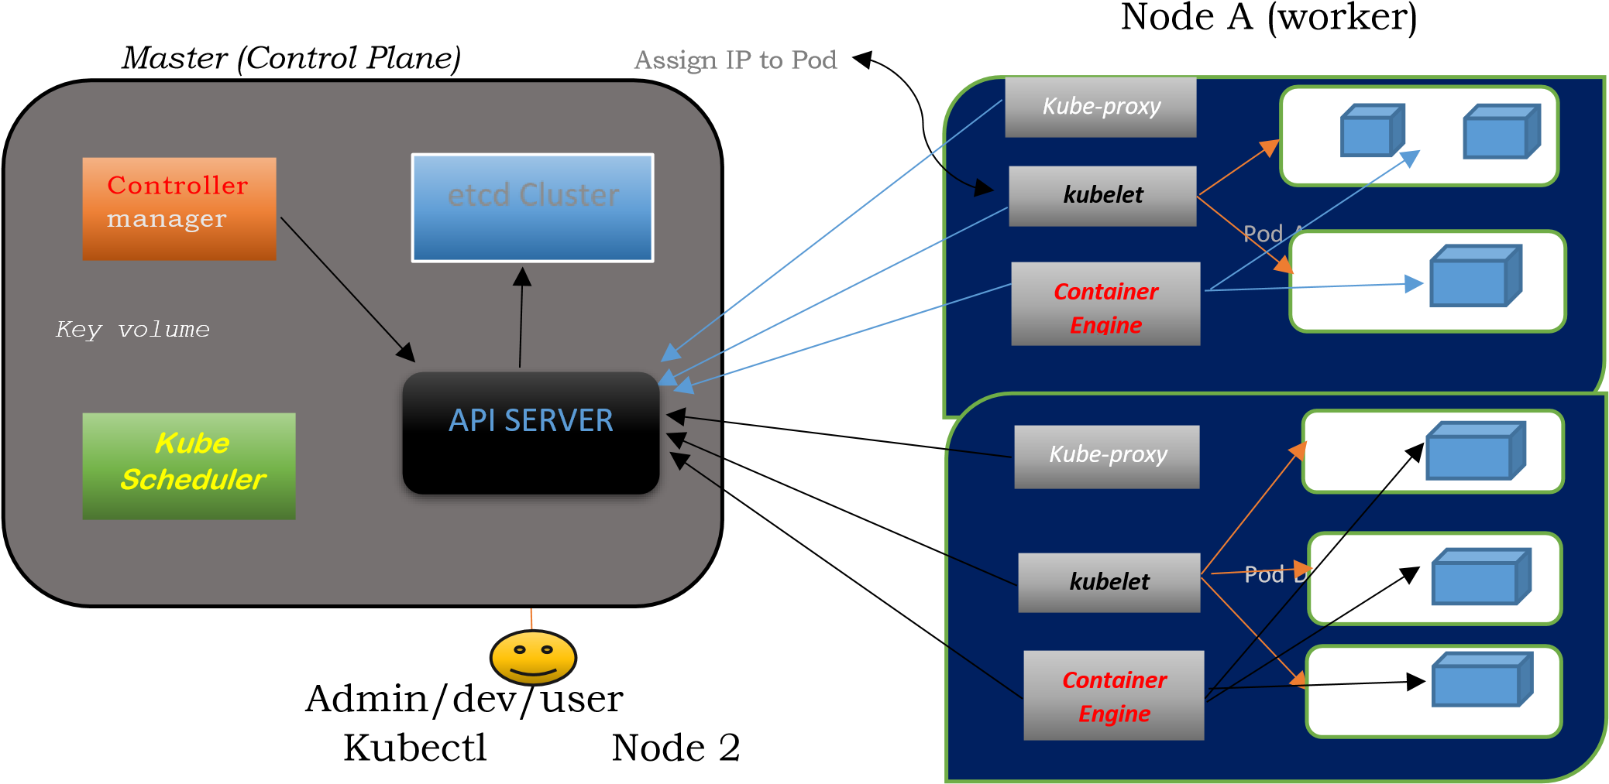
kubernetes architecture

Slide 10
Cont…
Kube API server
This interacts directly with user
(If we applied Jason or .YML manifest to kube API server).
The kubeAPI server is meant to scale automatically as per load.
Kube API server is front end of control-plane
etcd:-
It stores metadata and status of cluster.
It is consistent and H-A store (key volume store)
Source of Touch for cluster state. (Information about cluster’s state)

Slide 11
Cont…
Kube-Scheduler:
When user make request for the creation and management of PODS kube scheduler is going to take actions on these requests.
Handled POD creation and management. It match/assign any node to create and run pods. A scheduler watches for newly created pods that have no node assigned for every pod that the scheduler discovers, the scheduler becomes responsible for finding best node for that POD to run ON. Scheduler gets the information for hardware configuration from configuration files and schedules the PODS on nodes accordingly.
Controller manager:-
It makes sure actual state of cluster matches to desired state.
Two possible choices for controller manager:
If k8s on cloud then it will be cloud controller manager
If k8s on non-cloud, then it will be kube-controller manager

Slide 12
Cont…
Components on Master that runs controller:
Node–controller: - For checking the cloud provider to determine if a node has been detected in the cloud after it stops responding.
Route Controller: - Responsible for setting up network routes on your cloud.
Service controller: - Responsible for load balancers on your cloud against service of type load balancer.
Volume controller: - for creating attaching and maintaining volumes and interacting with the cloud provider to orchestrate volume.
POD: -
Smallest unit in kubernetes (usually contains 1 container).
It is a group of one or more container that are deployed together on the dame
host.
A cluster is a group of nodes which has at least 1 master and 2 worker nodes.

Slide 13
Cont…
In K8s Pod is the control unit not the container.
Pod runs on node which is control by master.
K8s communicates with pods not container.
Without POD we cannot start containers.
Multi-Container Pod:-
Share access to memory space.
Connect to each other using local host <container host>
Share access to the same volume
Container within pod are deployed in An, All or Nothing manner.
Entire pod is hosted on the same node (scheduler will decide about node).

Slide 14
Cont…
Pod limitations: -
No auto healing and scaling
Pod creases
Higher Level K8s Objects:-
Deployment: Versioning and Rollback
Replication set: Scaling and healing
Service: Static (non-ephemeral) IP networking
Volume: Non ephemeral storage

Slide 15
Objectives of the Work
The objective that we are trying to achieve is to deploy a application on Kubernetes
The simple solution to the above problem is using deploy the infrastructure using Kubernetes.
Scalability: Kubernetes allows for easy scaling of applications by creating and managing multiple instances of containers. This ensures that the application can handle increased traffic and workload.
High availability: Kubernetes ensures that the application is highly available by automatically deploying and managing containers across multiple nodes, and providing self-healing capabilities in case of node failures.
Resource utilization: Kubernetes optimizes resource utilization by allocating resources based on the application's requirements and the available resources in the cluster.
Consistency: Kubernetes ensures that the application environment is consistent across different environments, such as development, staging, and production.
Security: Kubernetes provides security features such as network policies, secrets management, and role-based access control, which help to protect the application and its data.
Simplified deployment: Kubernetes automates the deployment process, making it easier and faster to deploy the application across different environments.
Monitoring and logging: Kubernetes provides built-in monitoring and logging capabilities, allowing for better visibility into the application's performance and issues.

Slide 16
References
1."Kubernetes: A Complete DevOps Cookbook" by Vimal Kumar. This book covers the basics of Kubernetes, including deployment, scaling, and management.
2."Kubernetes in Action" by Marko Luksa. This book covers the practical aspects of deploying and managing applications on Kubernetes.
3."Deploying Microservices on Kubernetes" by Sean P. Kane and Karl W. Matthias. This article discusses how to deploy microservices on Kubernetes, including best practices for scaling and managing applications.
4."Managing Kubernetes with Kubernetes" by Brendan Burns. This article discusses how Kubernetes can be used to manage other Kubernetes clusters.
5."The Kubernetes Handbook" by Janakiram MSV. This article covers the basics of Kubernetes and includes practical examples of deploying and managing applications.

Slide 17

Thank you

